Slide 1
Asynchronous
Software Studio 軟體設計與實驗
Hung-Kuo Chu
Department of Computer Science
National Tsing Hua University
CS2410

Slide 2
Goal
Fork the repo to your local repository
Complete the index.js
Deadline: 2022/03/22 17:20

Slide 3
Goal
Data Generator
Follow get_info() and complete remain promise data generator: first name, last name, User name, email, address
Every generator’s success rate is 90% and random choose from three answers
First get_info, then get remain data
Use async / await
If automatic resample is checked, then retrieve the data again
If any data failed, show “failed” in txtInfoName

Slide 4
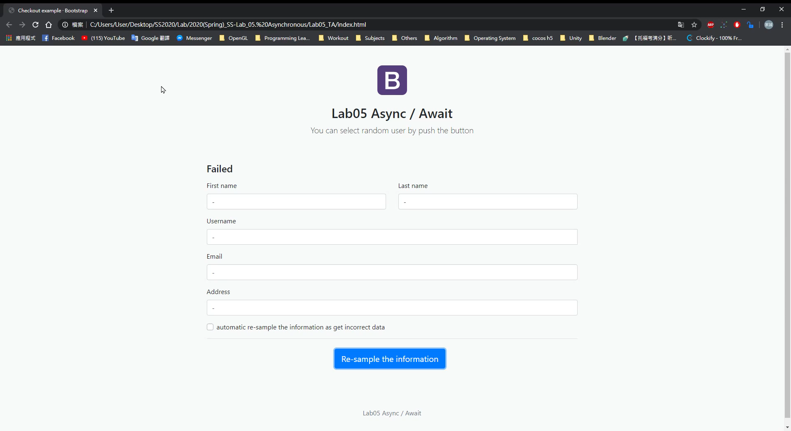
Goal example

Slide 5
Grading Policy
Item | Score
Generate data correctly | 30%
Use async / await | 25%
Generate get_info() first | 10%
Generate other 5 data at the same time (Promise.all) | 15%
Show failed in txtInfoName if any data failed | 10%
Automatic resample when checked if failed | 10%

